Slide 1
Credit card fraud detection
- By Eswar Sai S

Slide 2
OUTLINE
Basic Concepts
About the Dataset
Exploring the Features
Outcomes of Models Used
Comparison

Slide 3
Basic Concepts

Slide 4
credit card
A credit card is a thin rectangular piece of plastic or metal issued by a bank or financial services company, that allows cardholders to borrow funds with which to pay for goods and services with merchants that accept cards for payment.
Credit cards impose the condition that cardholders pay back the borrowed money, plus any applicable interest, as well as any additional agreed-upon charges, either in full by the billing date or over time.

Slide 5
credit card fraud
Credit card fraud is an inclusive term for fraud committed using a payment card. The purpose may be to obtain goods or services, or to make payment to another account which is controlled by a criminal.
There are two kinds of card fraud: card-present fraud (not so common nowadays) and card-not-present fraud (more common).

Slide 6
Types of credit card fraud
Application Fraud
Account takeover
Social engineering fraud
Skimming(theft of personal information)
Unexpected repeat billing

Slide 7
About the Dataset

Slide 8
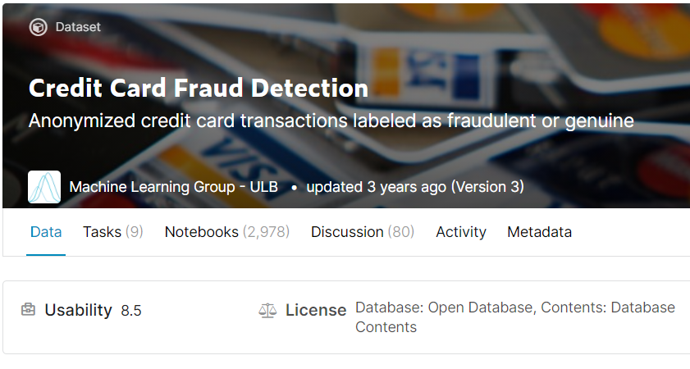
dataset
The dataset contains transactions made by credit cards in September 2013 by European cardholders.
This dataset presents transactions that occurred in two days, where we have 492 frauds out of 284,807 transactions.
The dataset is highly unbalanced, the positive class (frauds) account for 0.172% of all transactions. Features V1, V2, … V28 are the principal components obtained with PCA, the only features which have not been transformed with PCA are 'Time' and 'Amount'.

Slide 9
Exploring the Features

Slide 10
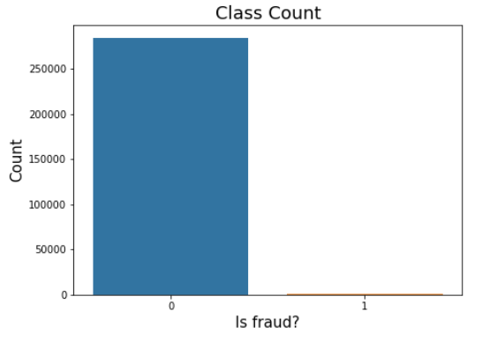
Target Variable (Class)
The feature ‘Class’ has only two values i.e., 0 being ‘Valid Transactions’ and 1 being ‘Fraud Transactions’.
The difference between the Classes i.e., fraud and valid transactions is too high, as we can see that the valid transactions are higher than 250000 and the fraud transactions are only 492 making it an imbalanced dataset. We need to handle it in the next slides.

Slide 11
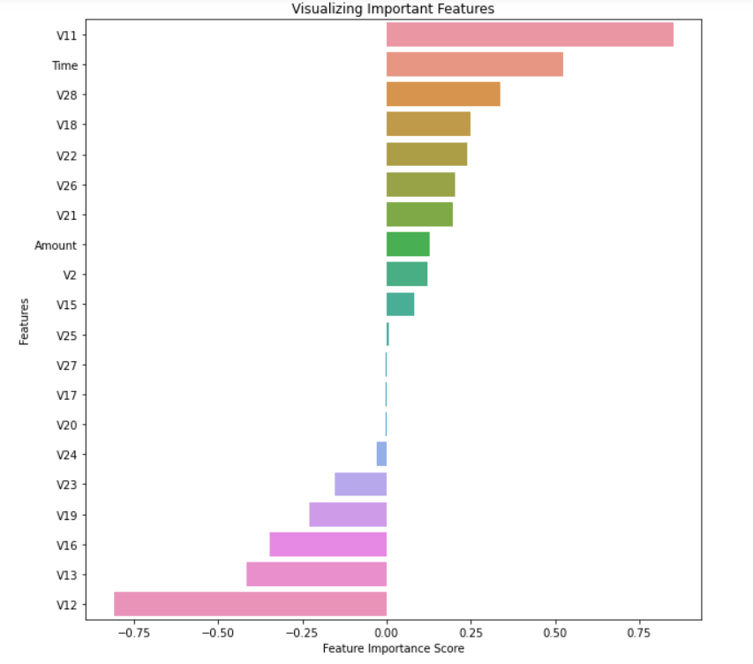
Important features
Except the dependent feature ‘Class’, the remaining features are the independent features. Out of them, the most impacting features from the dataset are as shown in the figure. The most important features are near to 1 and less important near to 0.
The features like V11, Time, V28, V12, V13, V16 and Amount are the most important features out of all of them, but we can see other important features which we need to consider as well.

Slide 12
Important Features (Contnd..)
The Important features are correlated either positively or negatively, that is if the feature value increases it is likely to be a fraud transaction and if the feature value is lower, it is likely to be a fraud transaction.
Here, the features like V12, V13, V16, V19 are negatively correlated and V11, V28, V18, V22 are positively correlated.
And also from Correlation matrices, found out the effect of the features with respect to the feature class i.e., if the transaction is a fraud.
Other than the above mentioned features, we have some information available with features like Time and Amount and we will look further more by exploring these features and get some insights in the next slides.

Slide 13
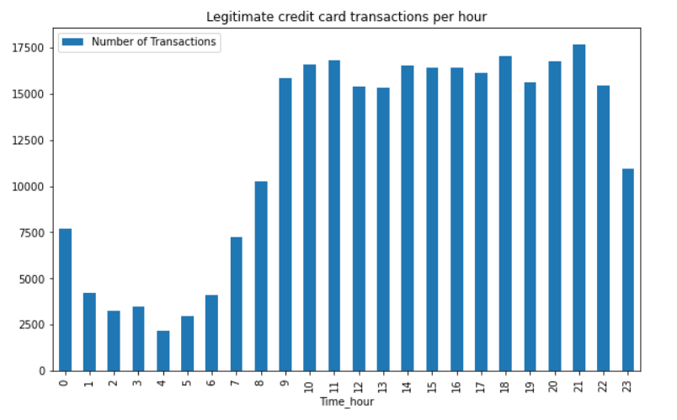
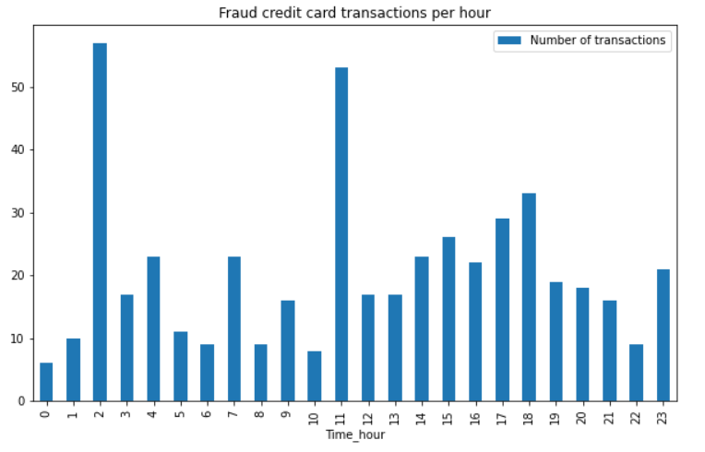
Time (Transactions per hour)
From the feature ‘Time’, we can see that within the 24 hours of a day, a good no. of valid transactions happened during 9AM to 11 PM, must be working hours.
The pattern for the no. of fraud transactions happened is not clearly obtained, might be because of the imbalanced data, but we can see that the fraud transactions are more spread out during the daytime.

Slide 14
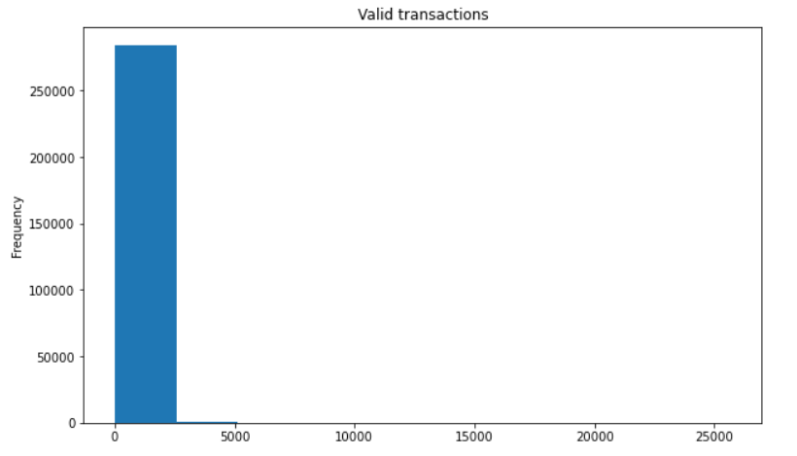
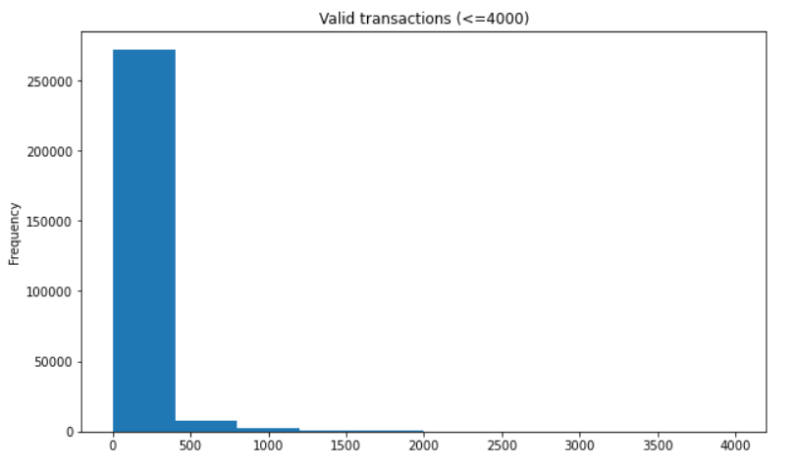
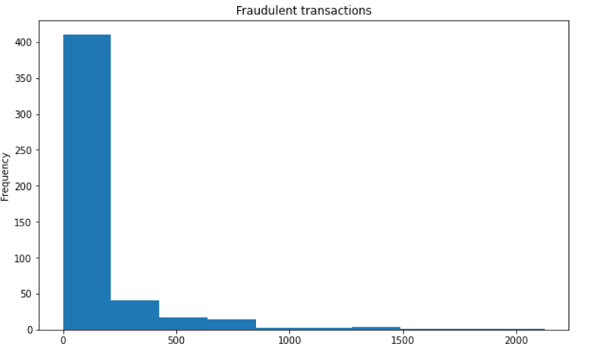
Amount Spent
From the feature ‘Amount’, we can see that the average amount spent on fraud transactions is higher than that of valid transactions but the amount spent on valid transactions is higher in absolute terms comparatively. But, visually we can’t find much difference. So, overall, we can’t find more patterns in this feature.

Slide 15
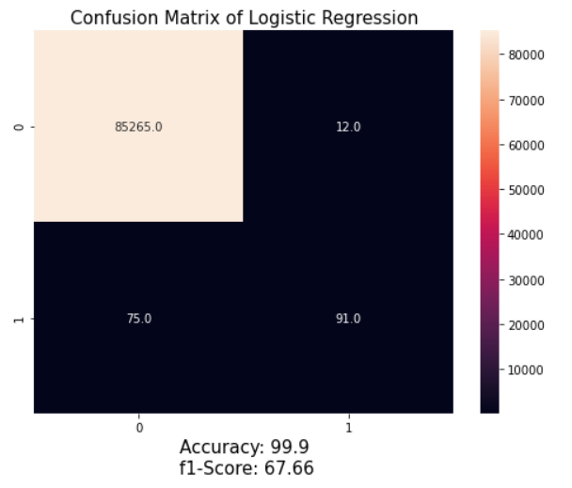
Logistic Regression (Imbalanced Data)

Slide 16
Techniques used to handle imbalanced data
UnderSampling
UnderSampling – NearMiss
OverSampling
OverSampling – SMOTE
Logistic Regression – Cost Sensitive
XGBoost

Slide 17
Outcomes of models used

Slide 18
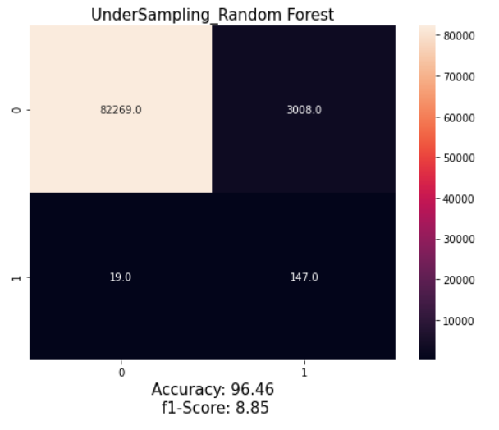
UnderSampling (RandomForest)

Slide 19
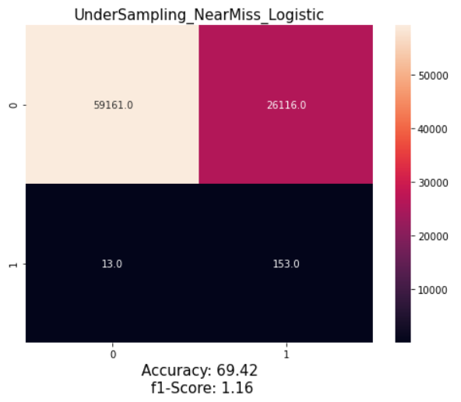
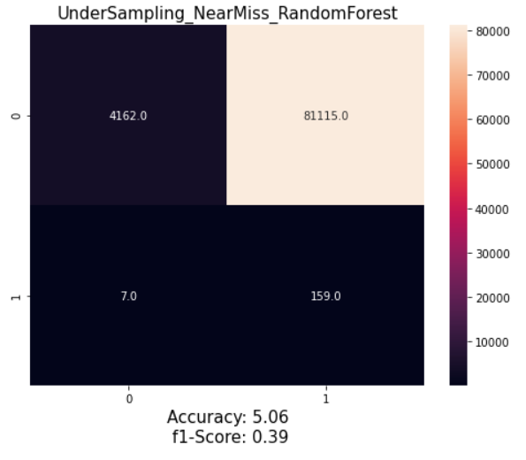
UnderSampling-NearMiss (Logistic & RandomForest)

Slide 20
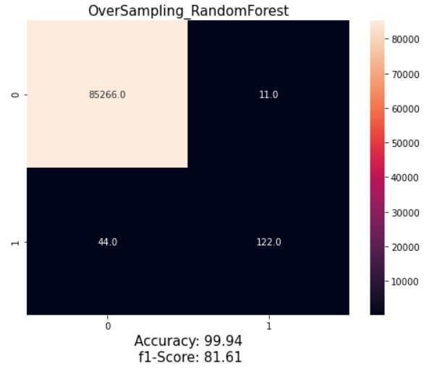
overSampling (RandomForest)

Slide 21
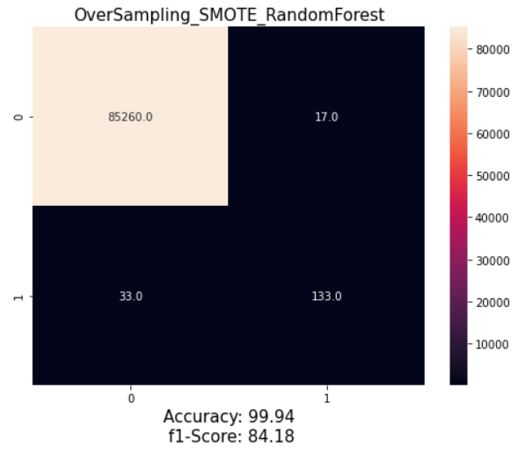
oversampling - Smote (RandomForest)

Slide 22
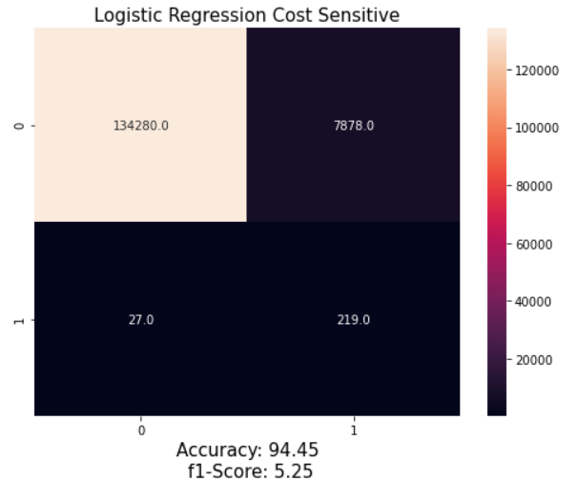
Logistic Regression - Cost Sensitive

Slide 23
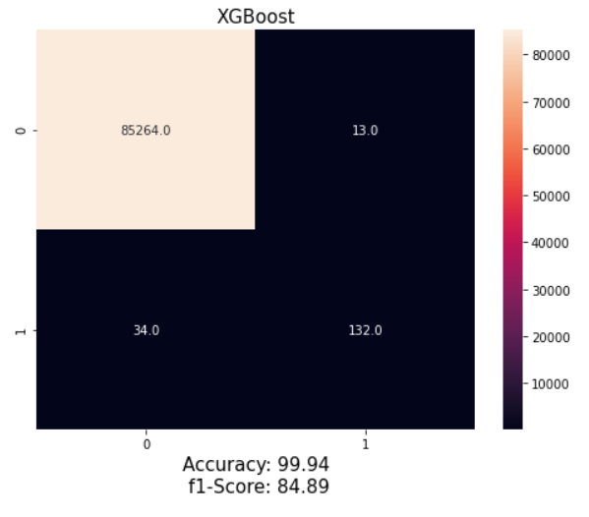
XGBoost

Slide 24
Comparison

Slide 25
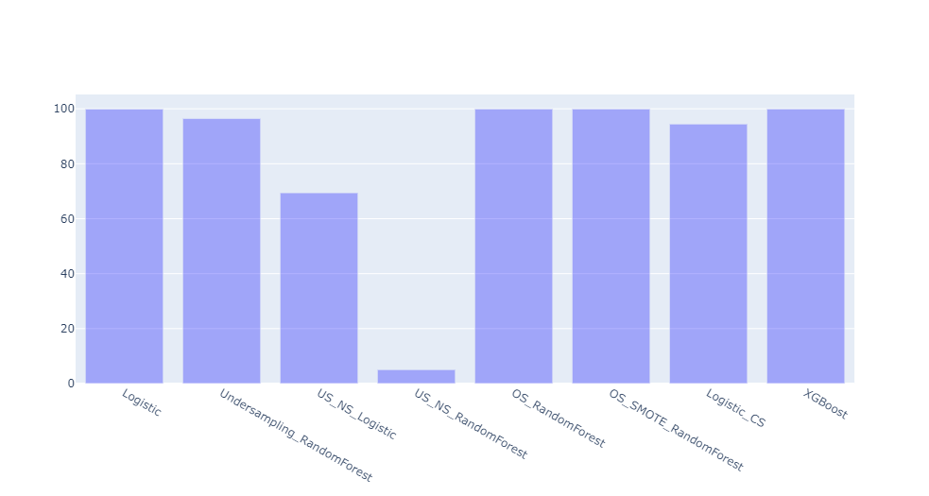
Accuracies of All Models

Slide 26
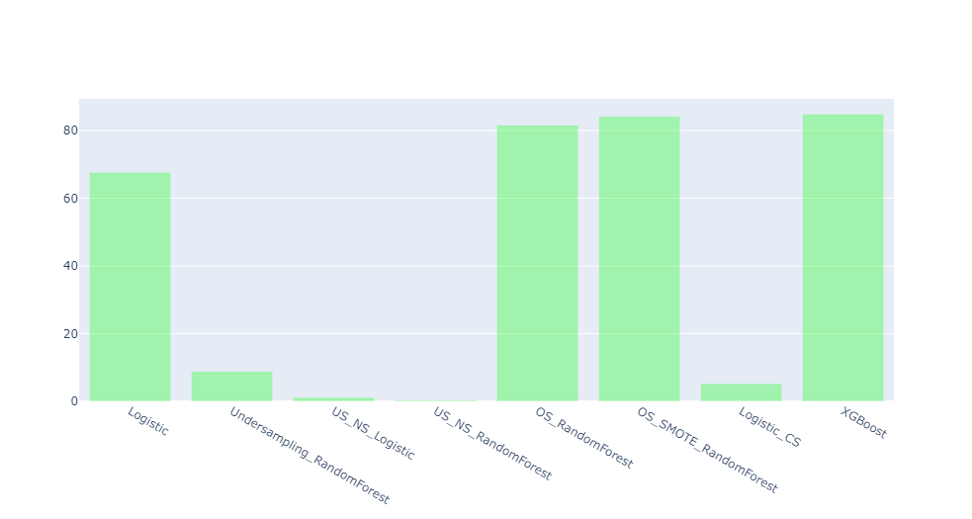
F1-Scores of All Models

Slide 27
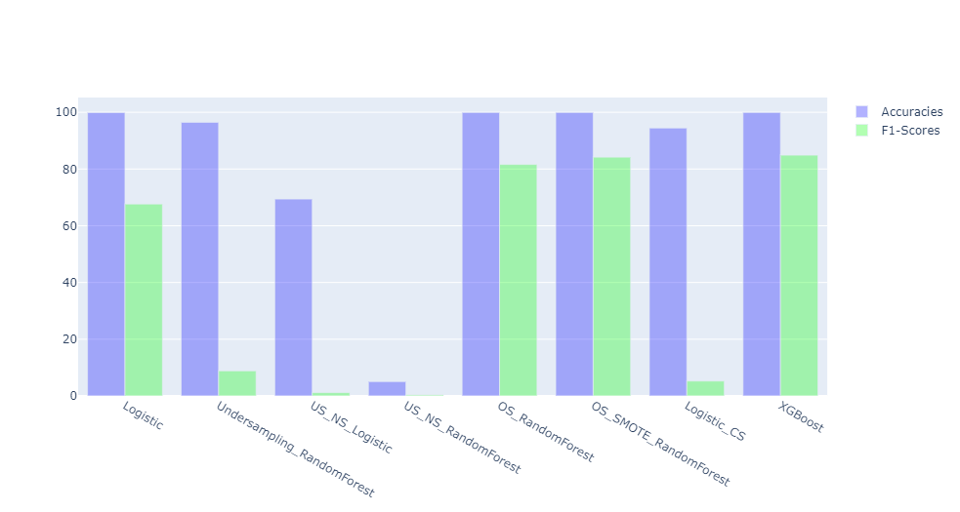
All at one place-1

Slide 28
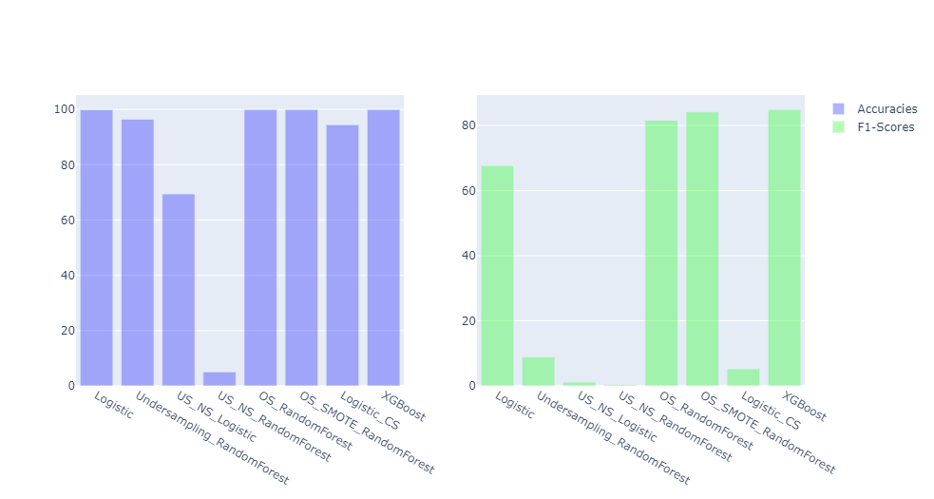
All at one place-2

Slide 29
Thank you!

